Slide 1

Deeplearning

Slide 2
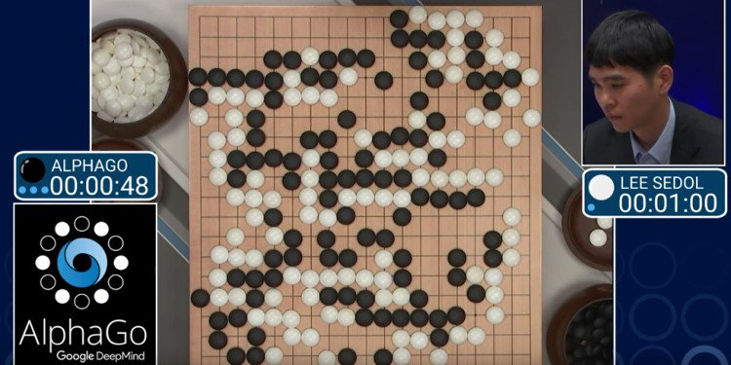
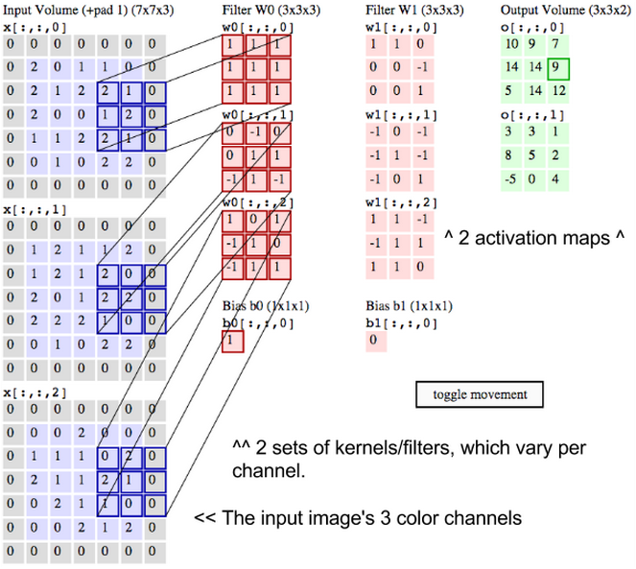
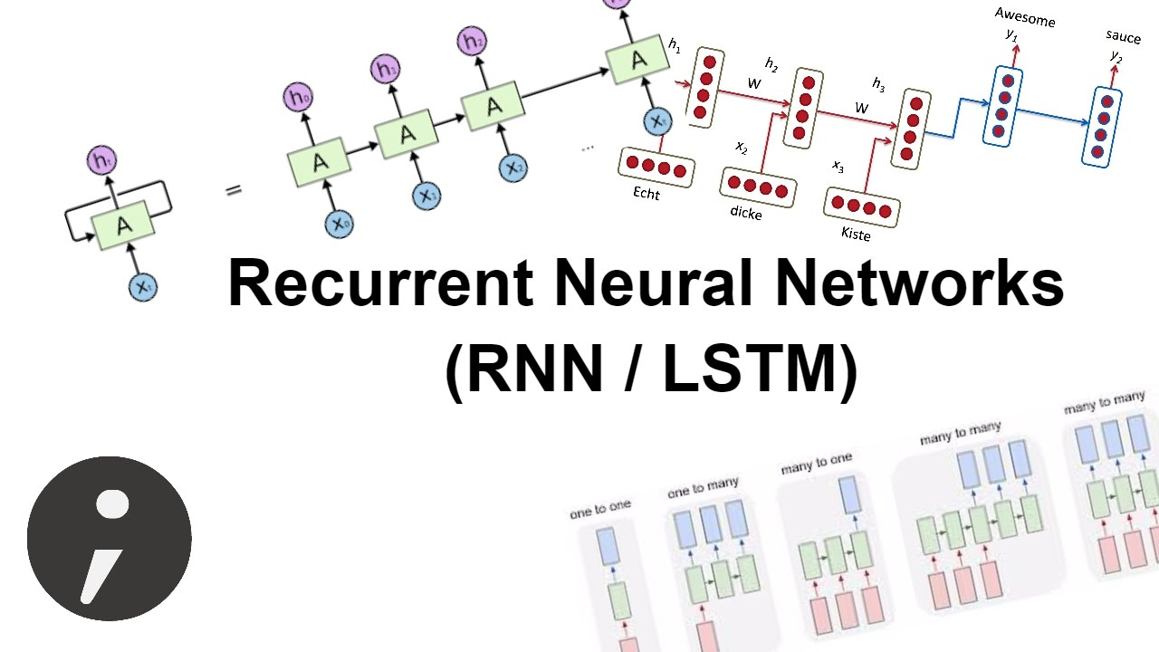

Slide 3
Supervised learning
Machine learning architechure
Machine learning model
Input: x
output
Output:
Real y
Compute
Compute
Loss fuction
Optimization
Output:
Predict y
Optimization

Slide 4
Supervised learning | Role of each part
Architecture
Loss function
Input
Input to architechure
- Initialize weight matrix
Compute output with input given
Optimize Weights base on
“signal” of loss function
Compute loss between output and target.
Tell Architecture how good did it work
Tell Architechture how to optimize weights

Slide 5
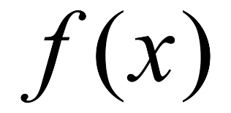
Supervised learning | Linear regression
output
Input: x
= x*w= w1*x1+ ….wn*xn
Weight matrix w
Compute
Input: x
X
Compute
Output:
Predict y
Loss fuction
Output:
Real y
Optimization

Slide 6
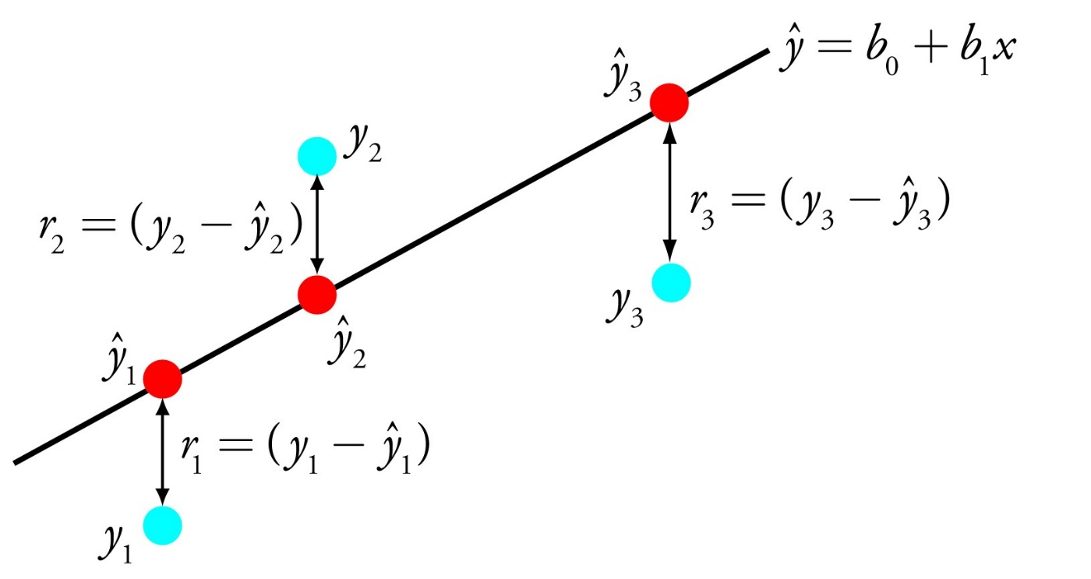
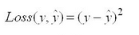
Supervised learning | Linear regression
Loss fuction

Slide 7


So, we already know all what we need!

Slide 8
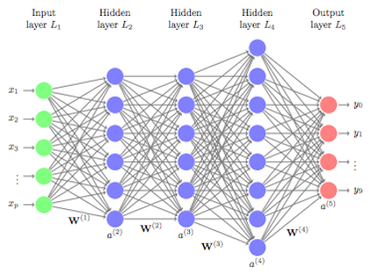
But, what about thing that people call “deep learning”?

Slide 9
It nearly the same with what we saw before
Machine learning architechure
Machine learning model
Input: x
output
Output:
Real y
Compute
Compute
Loss fuction
Output:
Predict y
Optimization
Optimization

Slide 10
Lets deep dive in to architechture
In linear regression, w - weight is a vector
= x*w = y
= [1,n]*[n,1] = [1,1] -scalar
If w is a matrix – what happen?
= x*w = y
= [1,n]*[n,m] = [1,m] - vector
If w and even x is a matrix – what happen?
= x*w = y
= [n,m]*[m,k] = [n,k] - matrix

Slide 11
Lets deep dive in to architechture
Just simple - “Deep learning” is a nested f(x)
X f(x) g(f(x)) h(g(f(x))) k(h(g(f(x))))
1x5 5x6 6x6 6x8 8x4

Slide 12
Lets deep dive in to architechture
And all others is features
X f(x) g(f(x)) h(g(f(x))) k(h(g(f(x))))
1x5 5x6 6x6 6x8 8x4

Slide 13
But what about
convolutional neural net
Recurrent neural net
Long shot term memory
Sequence-to-sequence
Deep pyramid convolution
Recurrent convolutional net
Very deep long shot term memory
….

Slide 14
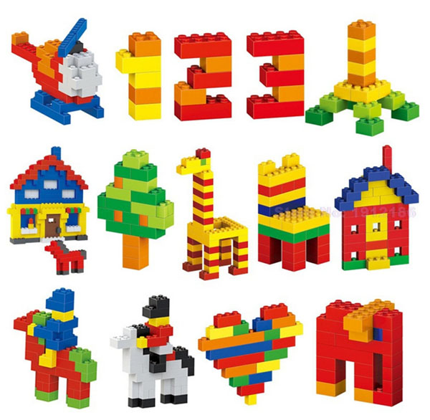
It is how we combine f(x) together – like lego

Slide 15
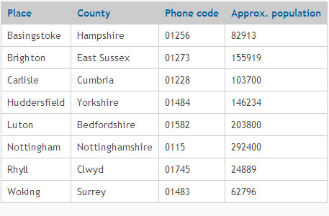


Let’s begin with type of input x
Vector
Fixed size, un-order
Tabular data
x
Fixed size, ordered
Image
matrix
Not Fixed size, ordered
Text, voice, …

Slide 16
Feed forward cell
Input: x
Feedforward cell
A vector
Output – a vector
nxm
1xm
1Xn

Slide 17
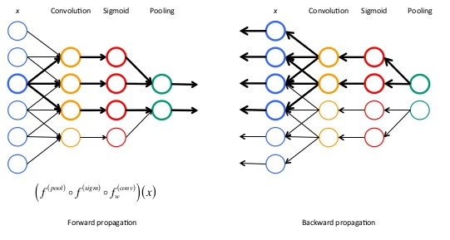
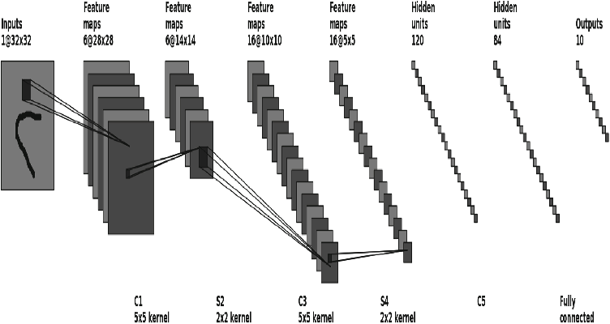
Convolutional CNN cell – output: tensor

Slide 18
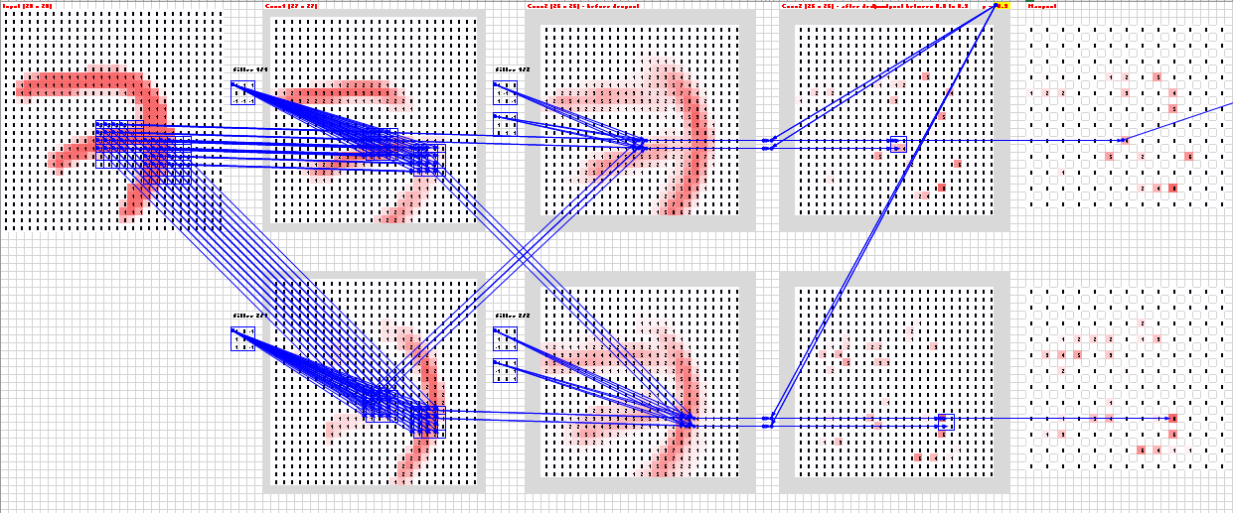

Slide 19
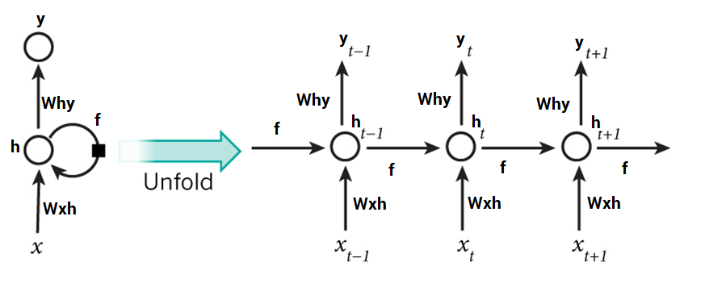
RNN cell – (RNN basic, GRU, LSTM)
Vector
mxk
RNN cell
Vector
1xn
Weights is shared between RNN cells

Slide 20
Feed forward net
Convolutional neuralnet
Input: x
CNN cell
flatten
Feedforward cell
Input: x
Feedforward cell
output
N*m*k
K is channel
N*m*k
,i*j*l
1,i*j*l
1xn
Nxm, mxk, kxj, jxh
hx1
Recurrent neural net
Recurrent - Convolutional neural net
Input: x
RNN cell
Feedforward cell
Input: x
CNN cell
RNN cell
Feedforward cell
%m%*n
%m%*k
N*m*k
K is channel
N*m*k
,i*j*l
%m%*k

Slide 21
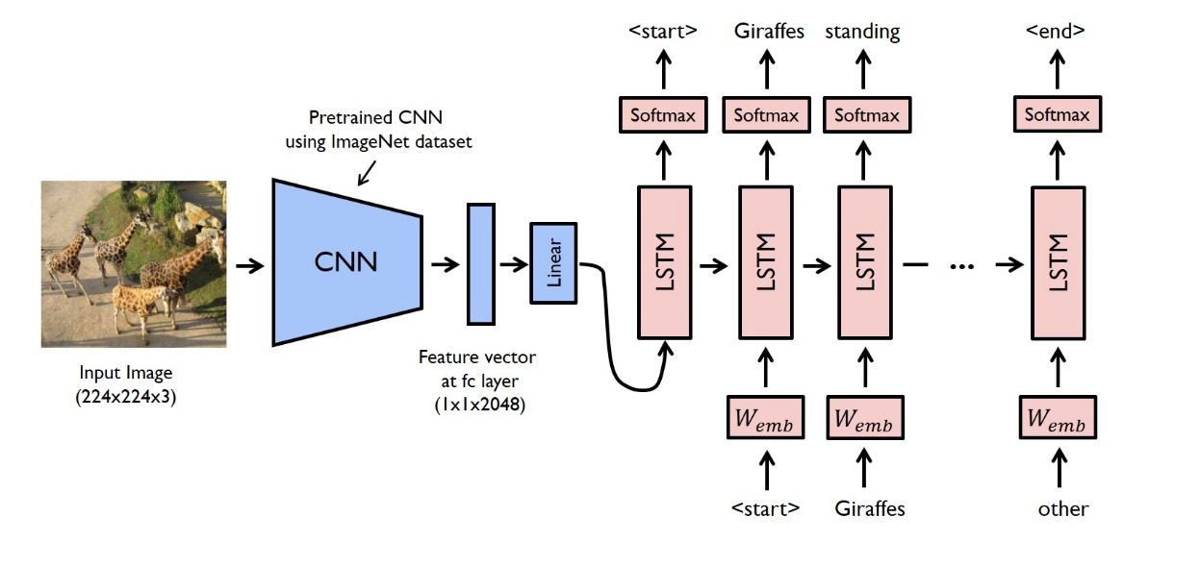
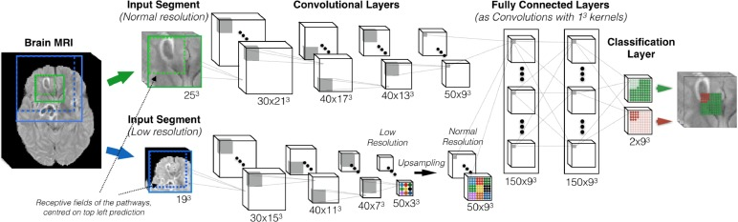
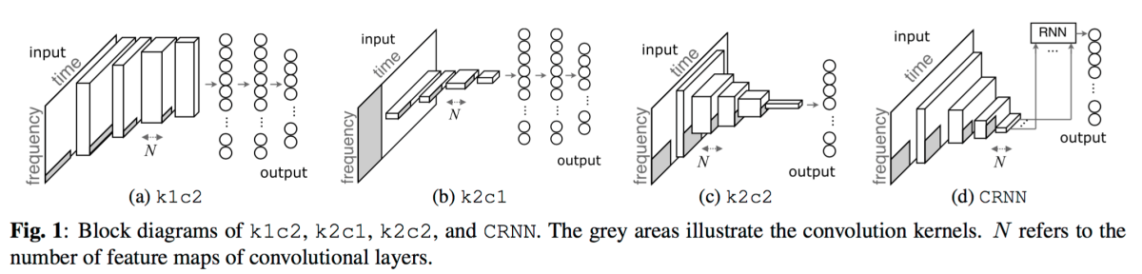

Slide 22
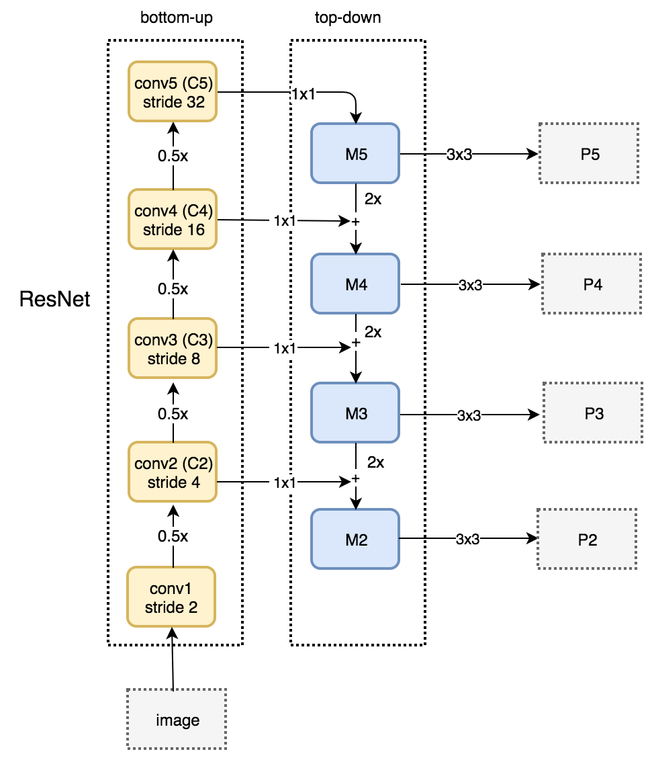
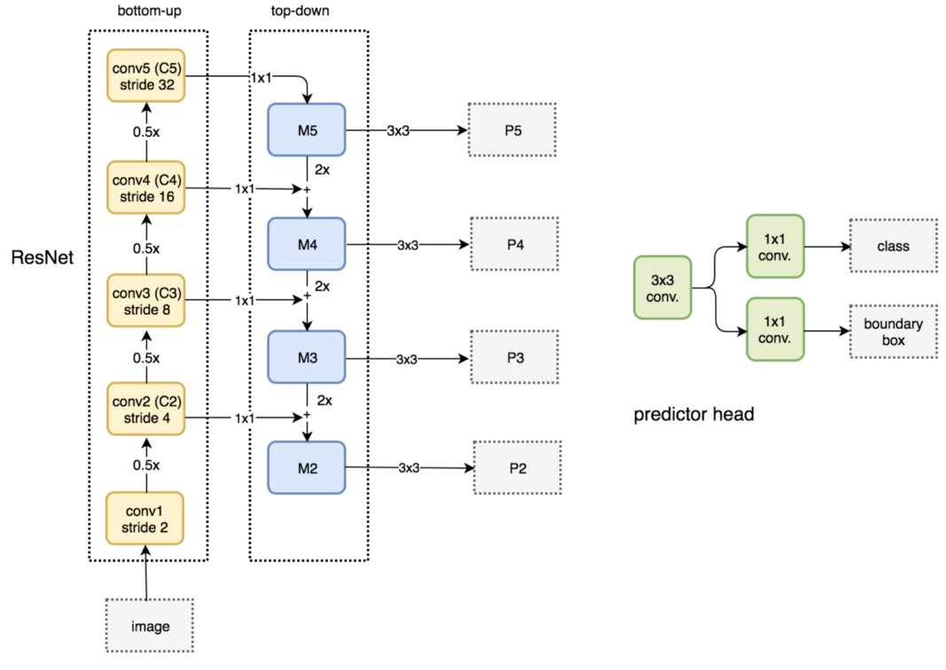

Slide 23


Pytorch vs tensorflow
Define and run.
Everything at very low level
Python
Object Oriented Programing
Research orient at very low level
to better customize architechture
-> Hard for compatible at production
Dynamic vs static
Very low level vs low level
Need front end for beginner
"Pythonic' vs "tensorflowic”
Customizeable vs
Appliable in production
Define -> computation graph (tf) -> run
Every thing at low level
Tensorflow self define nearly all method
Production oriented
for better performance at Google scale

Slide 24
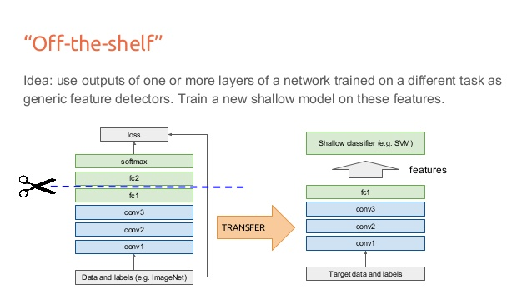
Best practice for practitioner
Transfer learning
Computer vision

Slide 25
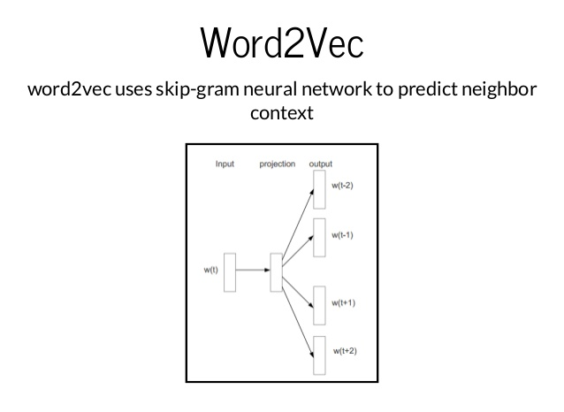
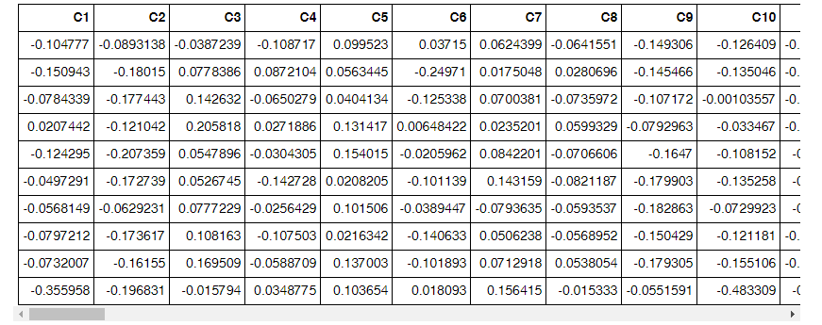
Trending on Deep learning Unsurpervised -> Representation -> Surpervised
Word vector – Representation of word

Slide 26
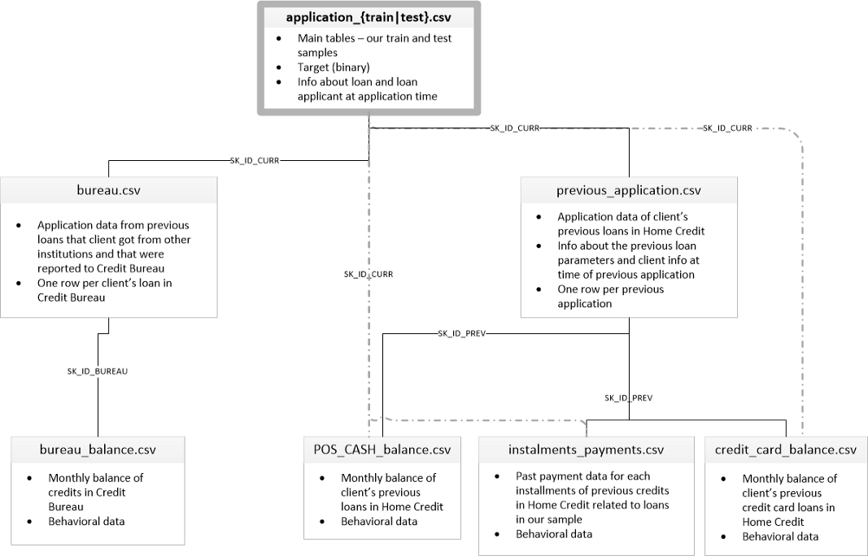
Case study | Default risk

Slide 27
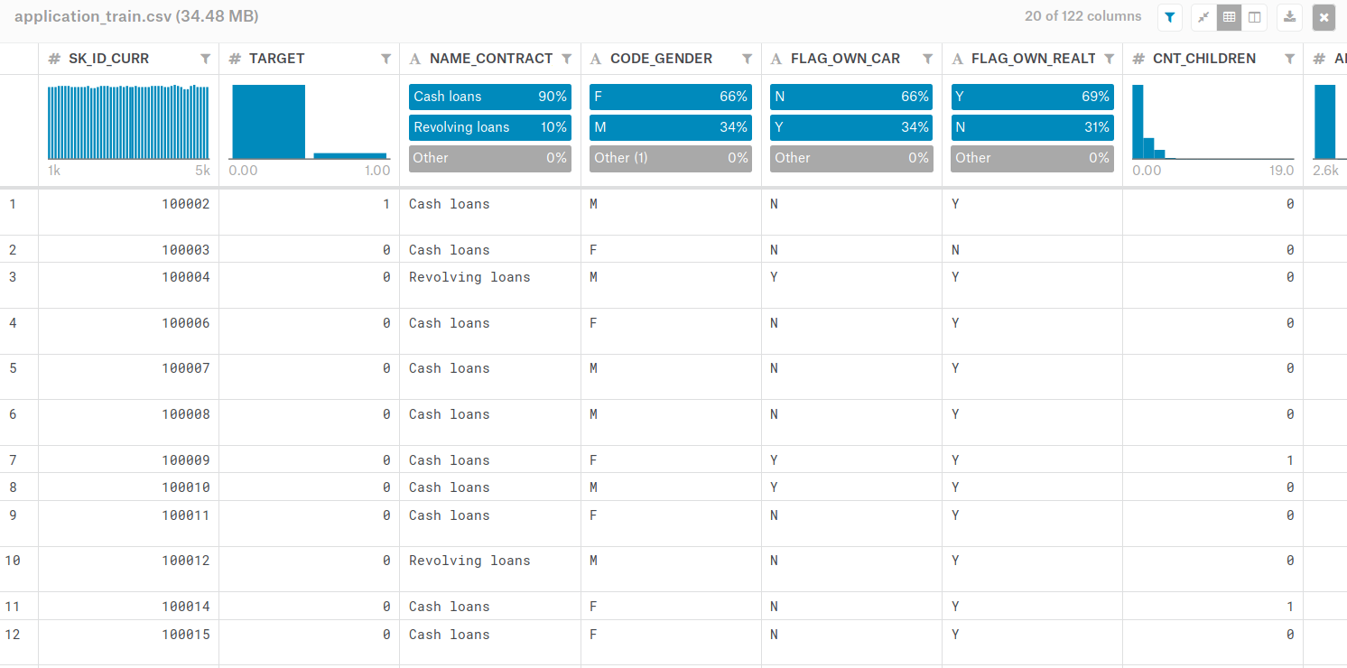
Case study | Default risk

Slide 28
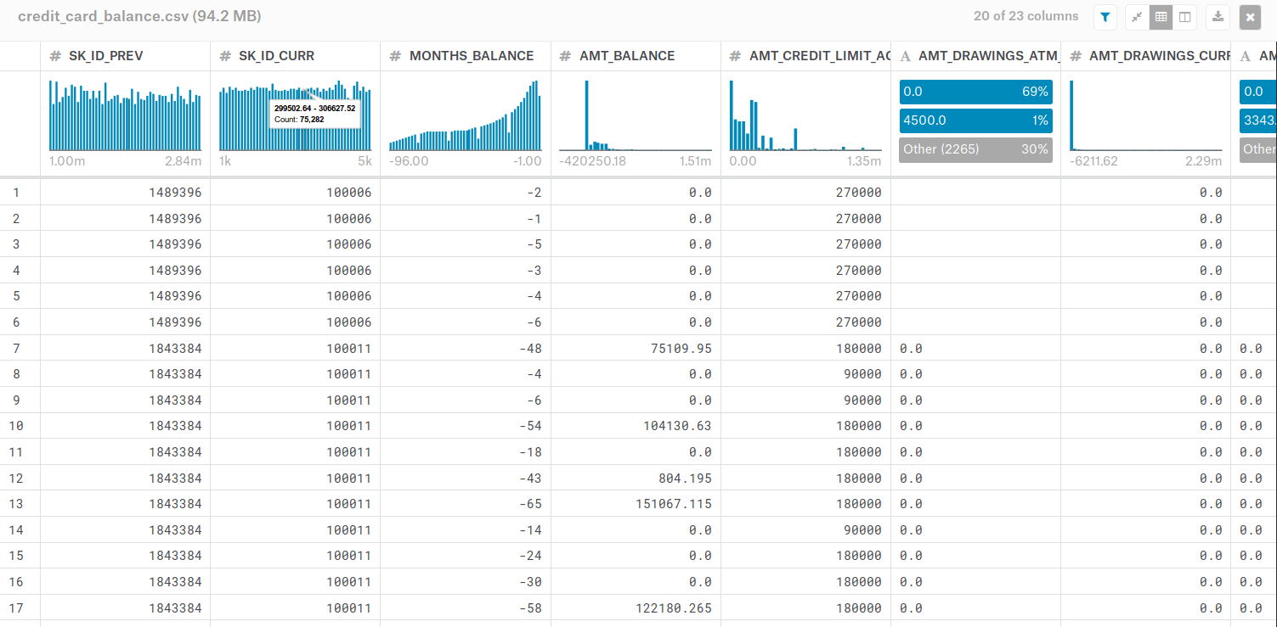
Case study | Default risk

Slide 29
Architechture
FFcell
Application_id = 1006
concatenate
1xn
1xm
RNN
cell
FFcell
1x64
App_train
6th 5th 4th 3th 2th 1th
Credit card balance

Slide 30
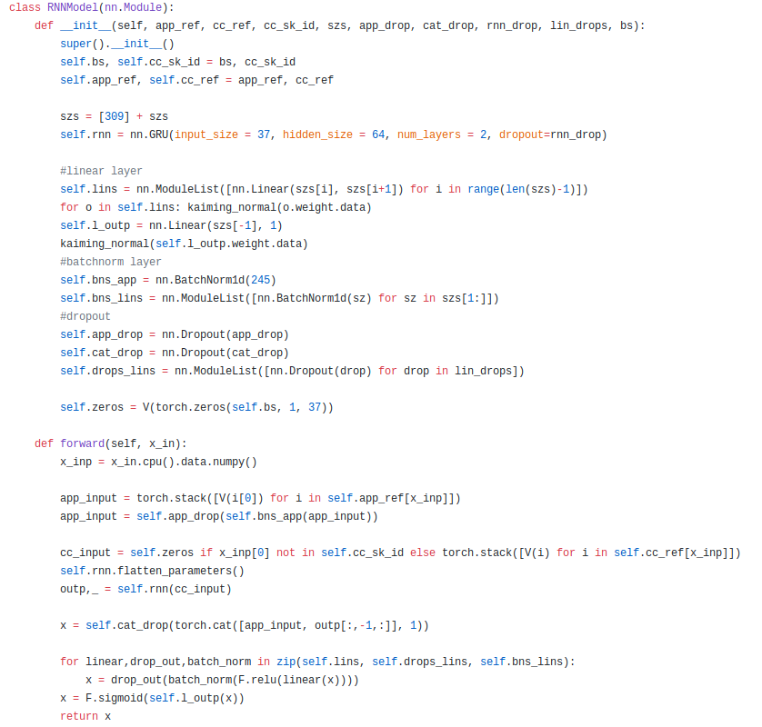
Code

Slide 31
Question?

